Slide 1
Protractor - Introduction
Prepared By: Shrish Tripathi

Slide 2

High Level Agenda
Pre-requisites
Why Automation Testing
How to Choose Automation tool
Programming Basics
Introduction to Protractor
Protractor Frameworks

Slide 3
Pre-requisites
Programming concepts
Idea of Object Oriented Programming concepts
JavaScript
TypeScript
AngularJS
Selenium Basics

Slide 4
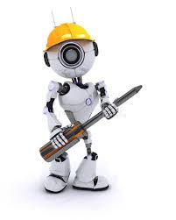
What is an Automation Tool
A software to help us in
Tests Execution
Tests Verification
Tests Reporting

Slide 5

Why we need Automation Testing
Saves Time and Money
Increases Correctness
Version changes
Increase Test Coverage
Increases speed, Efficiency Quality and Decreases cost
Helpful in Testing Complex Web Application

Slide 6

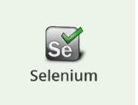
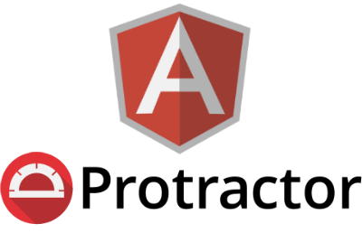
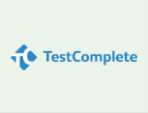



How to select right tool

Slide 7
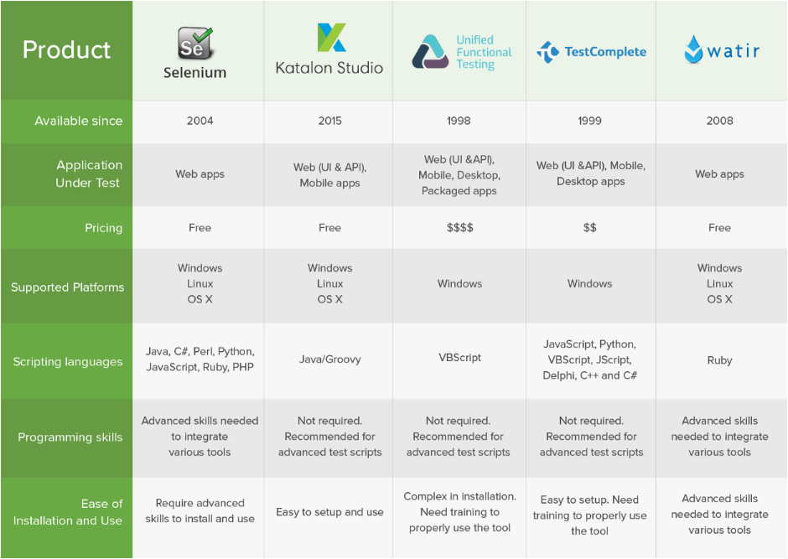
Steps to follow
1 – Collecting requirements
2 – Categorize your requirements
BASIC
TECHNICAL
BUSINESS
FEATURES
3 – Create tool list against Basic Requirement
4 - Shortlist tools
5 – Create chart for comparison and score card

Slide 8

Introduction to Core Programming concepts
Variables
Control structures
Data Structures
OOPS
AngularJS
JavaScript
Selenium

Slide 9
Introduction to Protractor
What is Protractor
Protractor is end to end test framework for AngularJS applications.
Protractor is built on top of web driver JS protocol, which uses native events and browser specific drivers to interact with your application

Slide 10
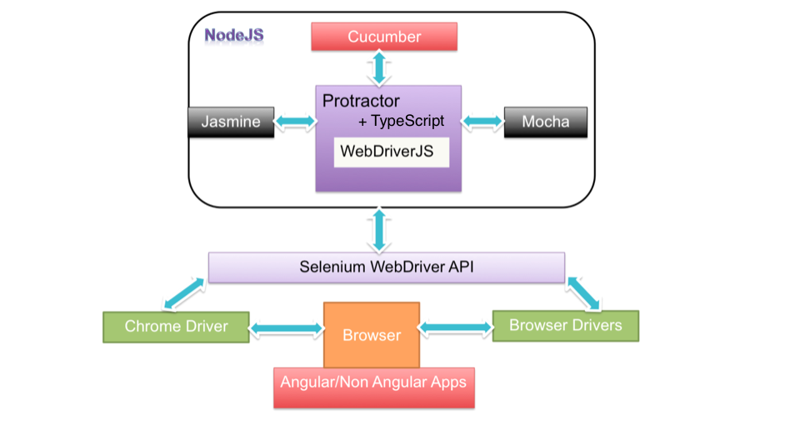

Slide 11
History of Selenium
Selenium is software testing framework web application which automates browsers.
Selenium Remote Control (RC) is a server, written in Java, that accepts commands for the browser via HTTP.
Selenium 2.0
Successor to Selenium 1.0
WebDriver introduces a JSON WIRE PROTOCOL for various language bindings to communicate with the browser controller.
WebDriver JS
WebDriver JS is simply a wrapper over the JSON wire protocol exposing high level functions to make our life easy.
It has two different bindings selenium driver & WebDriver JS based on node module.
Node JS
Node.JS is a server side platform built on google chrome’s JavaScript engine(V8 Engine)
Asynchronous and Event Driven
Single threaded but highly scalable

Slide 12
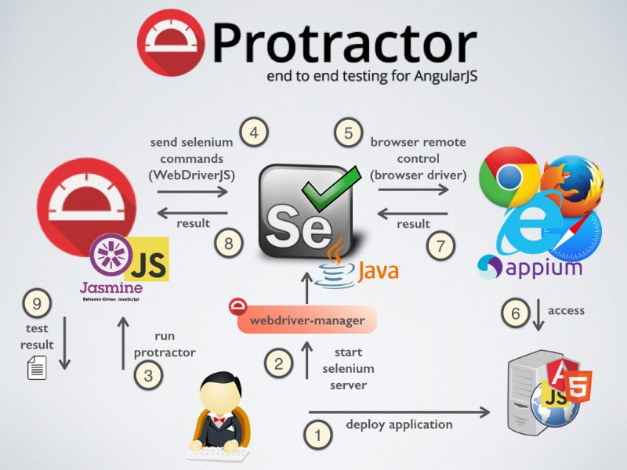
Protractor Automation flow

Slide 13


Slide 14


